Slide 1
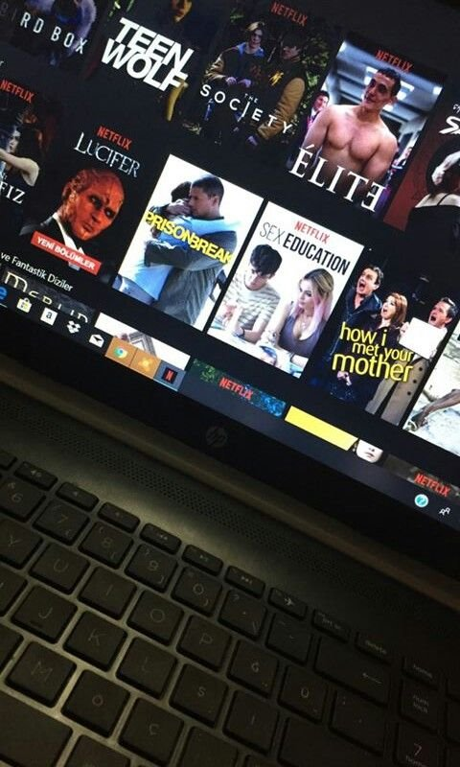

FILM FLICKS FINDER

Slide 2
TEAM MEMBERS
AMAN DHIMAN (2200290140023)
AMAN KUMAR (2200290140024)
PROJECT SUPERVISOR
Ms. Divya Singhal (Assistant Professor)

Slide 3

HOMEPAGE

Slide 4
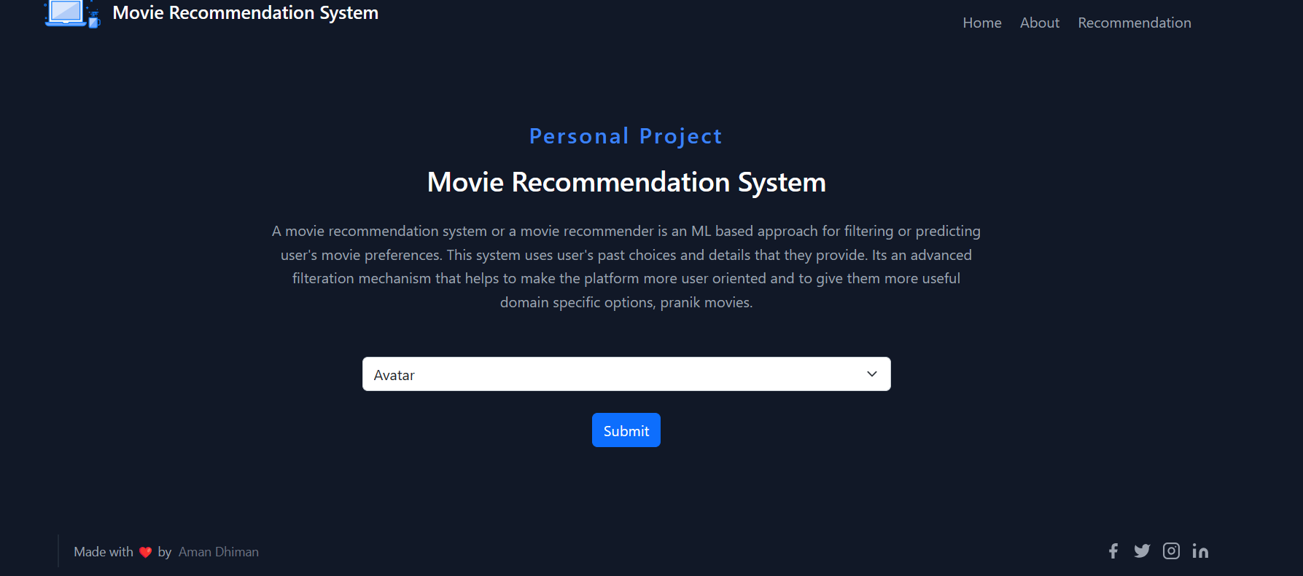
RECOMMANDATION SYSTEM

Slide 5
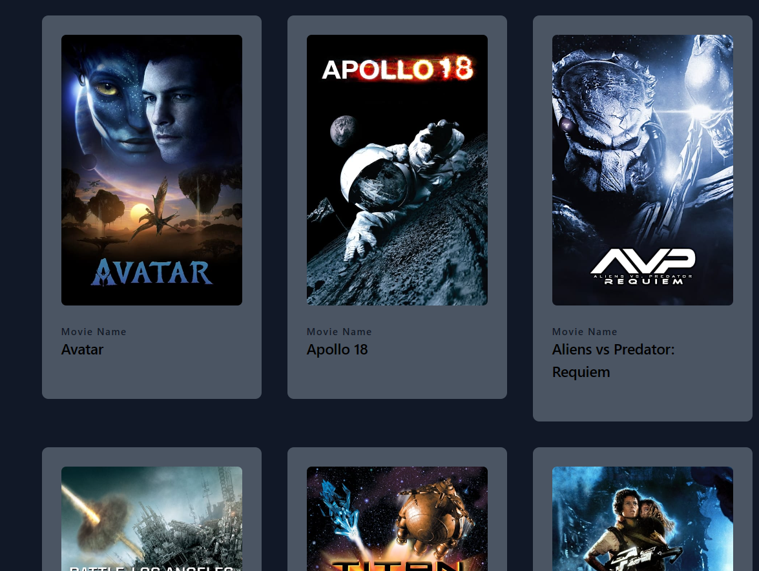

Slide 6


Slide 7


